Slide 1

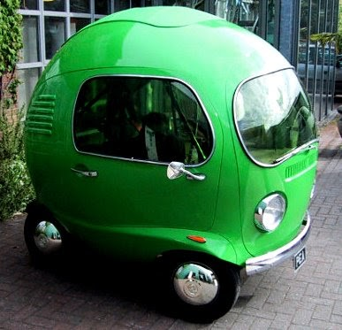
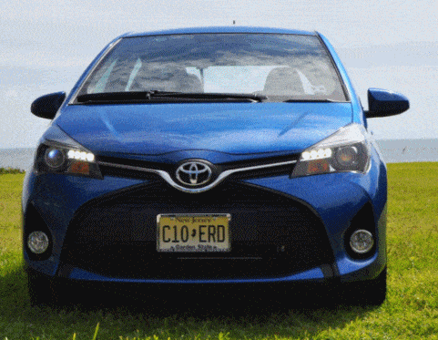
T h e g r o u p
By Charlie, Will, Liam and Redwan

Slide 2
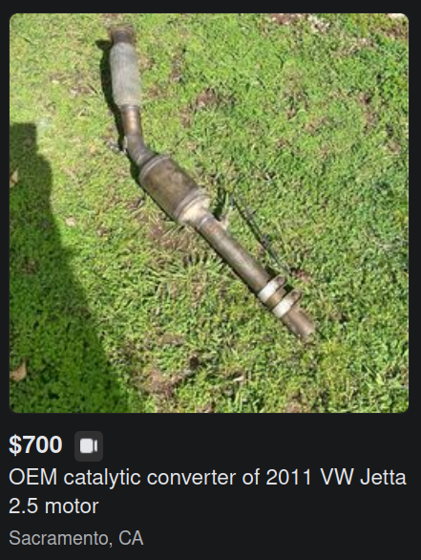
What is the website about?
This website is about 100% not stolen catalytic converters.
It is about selling used hollow catalytic converters

Slide 3
WHAT we used TO CREATE THE Website
Software used:
HTML
CSS
CHATGPT
JAVASCRIPT
CO-PIOLT FROM BING

Slide 4
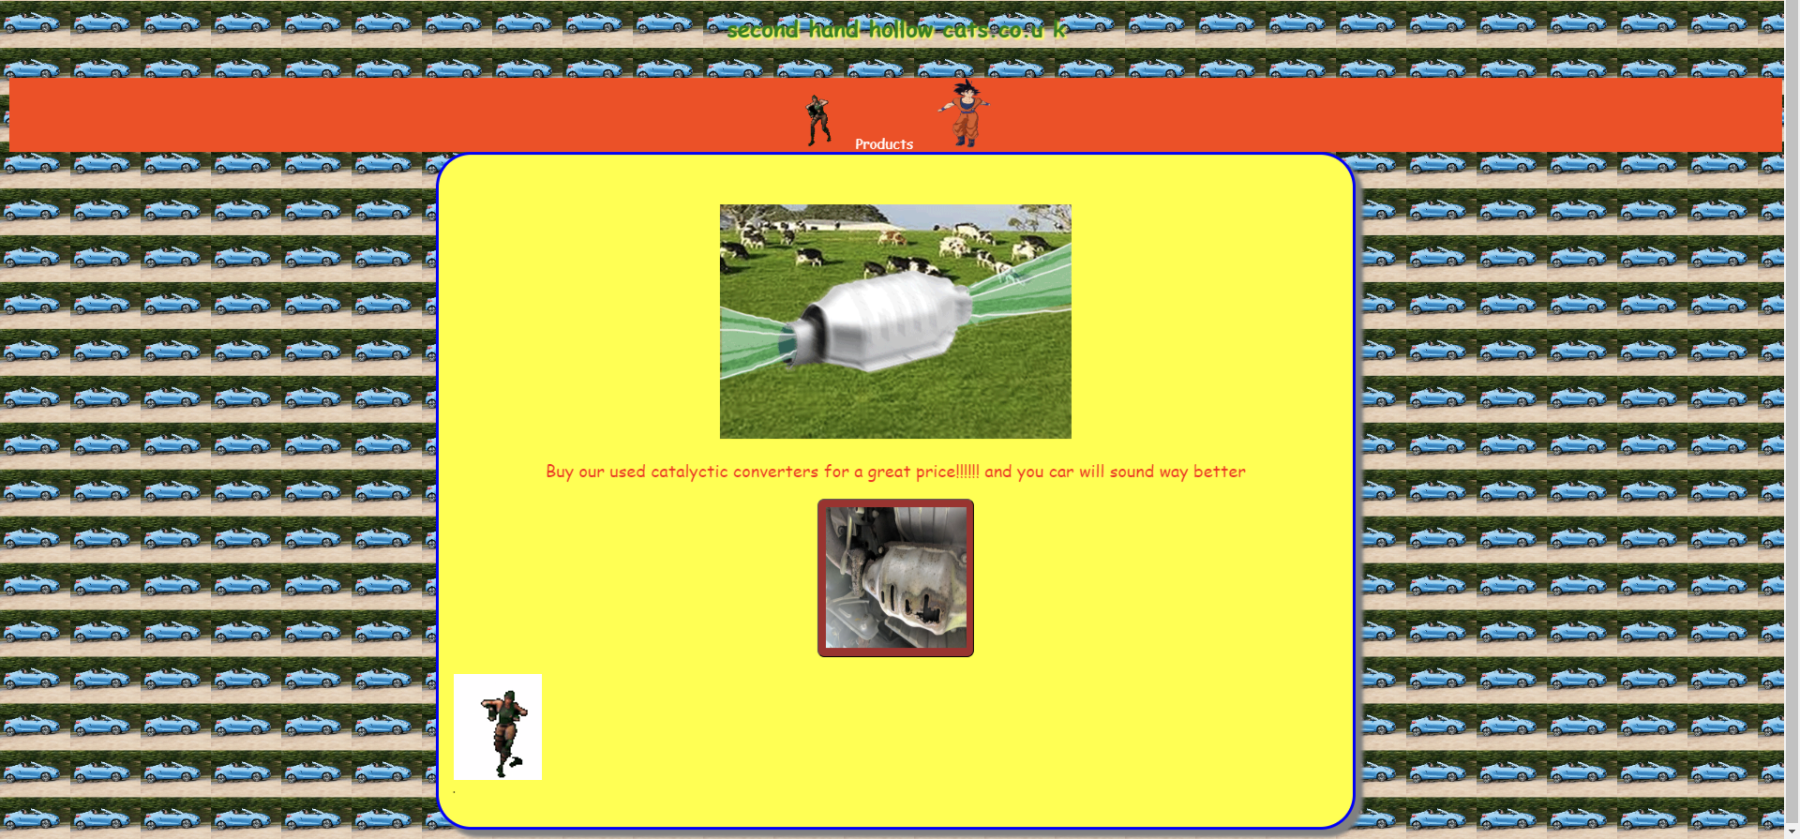
Website Preview
The Website is supposed to allow users to buy catalytic converters

Slide 5
Reflection
1 What happened? (Facts)
2 How did it feel? (Emotions)
3 What do we think? (Analysis, interpretation)
4 What will we do next? (Action)

Slide 6
Any Questions?

